Slide 1

CROP YIELD PREDICTION
Hack0ut’24

Slide 2
INTRODUCTION
Crop yield prediction is one of the challenging tasks in agriculture. It plays an essential role in decision making at global, regional, and field levels. The prediction of crop yield is based on soil, meteorological, environmental, and crop parameters. Decision support models are broadly used to extract significant crop features for prediction. Precision agriculture focuses on monitoring (sensing technologies), management information systems, variable rate technologies, and responses to inter- and intravariability in cropping systems. The benefits of precision agriculture involve increasing crop yield and crop quality, while reducing the environmental impact.
AGRICULTURE

Slide 3
Contents
Impacts
Road Map
Technologies Used
Challenges & Risks
Existing Technologies
Solution By Our Model

Slide 4
01
IMPACT

Slide 5

IMPACT
→ Crop yield simulations help to understand the cumulative effects of water and nutrient deficiencies, pests, diseases, the impact of crop yield variability, and other field conditions over the growing season.

Slide 6
02
ROADMAP

Slide 7
Data collection & storage.
Features extraction.
Model Development.
User Interface design.
Testing Our Model.
Integrating with Front-end & Back-end.
Finalizing Our Model.

Slide 8
03
TECHNOLOGIES USED.

Slide 9
Technologies Used
Machine Learning
Front-End
Back-End
Python Integration With
Various Libraries.
PyScript is used for designing interface
Various concepts of python & Html will be used .

Slide 10
04
Challenges & Risks

Slide 11
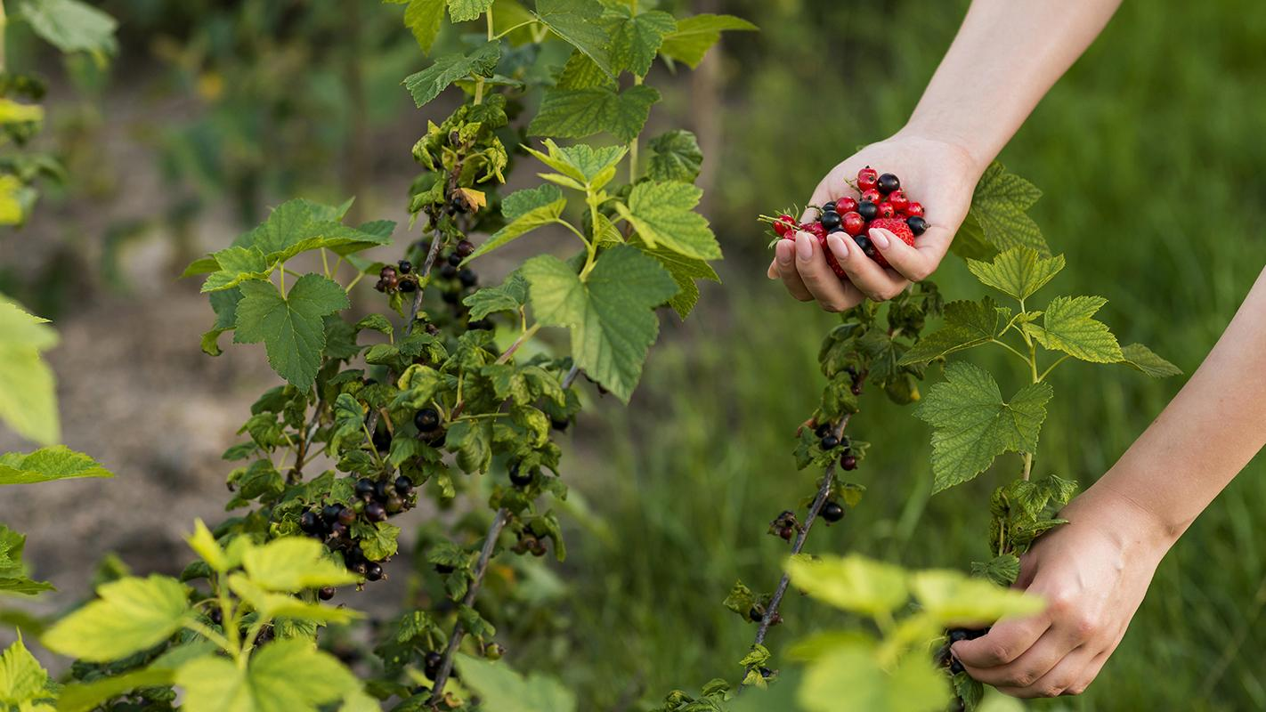
Challenges & Risks
Risks
Challenges :-
ClimateChange,Resource Scarcity, Investment & Funding Challenges.
Crop Failure,Operational Risks, production Risk.

Slide 12
05
Existing Technologies.

Slide 13
Existing Technologies
Crop modelling
GIS
Climate & Soil Data integration

Slide 14
06
Solution By Our Model .

Slide 15
Solution By Our Model
Our Model will solve all the all the challenges which peoples are facing & we will try to give them easiest cum understandable model & we will also try to give them the best advices according to their soil contents. For Example: our Model will tell that which crops should be grown & how much amount of water will be suitable & what kind pests can attract & we will give the suitable solution for the pest control to the users.

